Slide 1
STORAGE TYPES

Slide 2
WHAT IS DAS?
Direct attached storage (DAS), also called direct attach storage, is digital storage that is attached directly to a computer or a server. In other words, DAS isn't part of a storage network.
The most familiar example of DAS is the internal hard drive in a laptop or desktop PC.
DAS can refer to a single drive or a group of drives that are connected together. In addition, DAS devices can be housed inside a PC or server or outside the PC or server.
DAS creates data islands, because data cannot be shared with other servers.

Slide 3
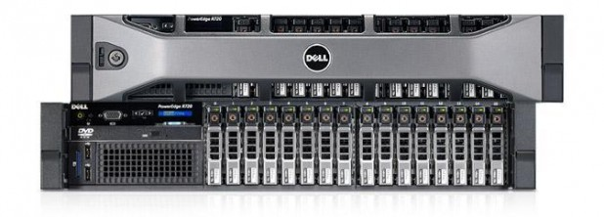
Most PCs and many servers come with DAS already installed, and if you want to add more direct attached storage, generally all you need to purchase is a storage device and possibly a cable.
Connecting additional DAS devices to servers is a little more complicated than adding DAS to a PC, but it is generally simpler than connecting SAN or NAS devices because it doesn't require you to design a network or purchase hardware like routers and switches.

Slide 4
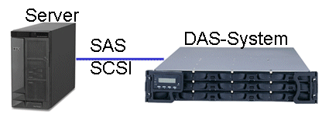
DAS Technology:
DAS devices can utilize traditional spinning hard disk drives or solid state media. Hard disk drives (HDDs) are less expensive than solid state drives (SDDs) on a per gigabyte basis. However, they aren't as fast as SDDs.
The majority of DAS devices sold today use hard disk drives, although SSDs and hybrid devices are becoming more popular, particularly for applications where performance is paramount, such as Big Data analytics.

Slide 5
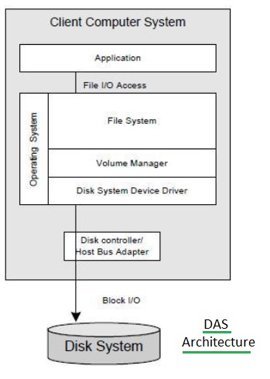
DAS Software Architecture

Slide 6
WHAT IS SAN?
Storage Area Network (SAN) is a high-speed network of storage devices that also connects those storage devices with servers. It provides block-level storage that can be accessed by the applications running on any networked servers.
SANs are particularly helpful in backup and disaster recovery settings.
Within a SAN, data can be transferred from one storage device to another without interacting with a server. This speeds up the backup process and eliminates the need to use server CPU cycles for backup.

Slide 7
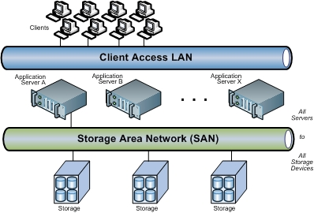
SANs utilize Fibre Channel technology or other networking protocols that allow the networks to span longer distances geographically. That makes it more feasible for companies to keep their backup data in remote locations.
Fibre Channel is currently the most widely used communication protocol for SANs.

Slide 8
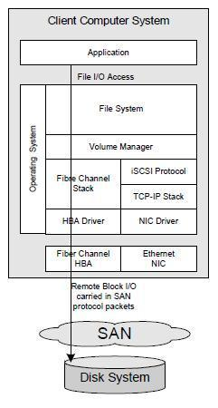
SAN Software Architecture

Slide 9
LOGICAL UNIT NUMBER
In computer storage, a logical unit number, or LUN, is a number used to identify a logical unit, which is a device addressed by the Storage Area Network protocols which encapsulate SCSI, such as Fibre Channel or iSCSI.
A LUN may be used with any device which supports read/write operations, such as a tape drive, but is most often used to refer to a logical disk as created on a SAN.
The logical unit may be a part of a storage drive, an entire storage drive, or all of parts of several storage drives such as hard disks, solid-state drives or tapes, in one or more storage systems.
The capacity limit of a LUN varies by system.

Slide 10
TYPES OF LUNs
Mirrored LUN:
Fault-tolerant LUN with identical copies on two physical drives for data redundancy.
Concatenated LUN:
Consolidates several LUNs into a single logical unit or volume.
Striped LUN:
Writes data across multiple physical drives, potentially enhancing performance by distributing I/O requests across the drives.

Slide 11
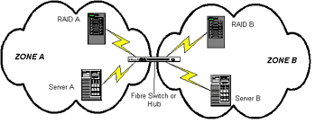
ZONING
SAN zoning is a method of arranging Fibre Channel devices into logical groups over the physical configuration of the fabric.
SAN zoning may be utilized to implement compartmentalization of data for security purposes.
Each device in a SAN may be placed into multiple zones.

Slide 12
iSCSI
In computing, iSCSI is an acronym for Internet Small Computer Systems Interface, an Internet Protocol (IP)-based storage networking standard for linking data storage facilities. It provides block-level access to storage devices by carrying SCSI commands over a TCP/IP network.
The protocol allows clients to send SCSI commands to storage devices on remote servers.
It mainly competes with Fibre Channel, but unlike traditional Fibre Channel which usually requires dedicated cabling, iSCSI can be run over long distances using existing network infrastructure.

